Slide 1


Lab 1 Introduction

Slide 2

Socket programming

Slide 3

Socket
These two process should be different computer
Using IP + port + protocol to describe a communication

Slide 4
TCP
Transmission Control Protocol
Reliable(Three-way handshake)
Retransmission
Deprecate duplicated packets
congestion control/ flow control

Slide 5
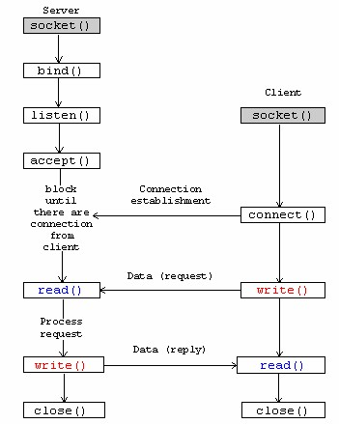
TCP flow
Establish socket
Bind address and socket
Listen for request
Accept request from client
Read socket
Write socket
Close socket

Slide 6
Using System Call
socket(AF_INET, SOCK_STREAM, 0)
AF_INET : address family, ipv4
SOCK_STREAM : connection type, for TCP(SOCK_DGRAM for UDP)
Return type : int
bind(sockfd, (struct sockaddr*)& server_addr, sizeof(server_addr))
sockfd : socket descriptor
server_addr
server_addr size
Notes:
man socket

Slide 7
Using System Call
listen(int sockfd, int backlog);
backlog : how many client can access the server
accept (int sockfd, struct sockaddr addr, socklen_t addrlen);
Accept the access for the client connection
The addr will record the client address

Slide 8
UDP
User Datagram Protocol
Unreliable and more fast
no guarantee of transferring data bits or packets in an arranged manner

Slide 9
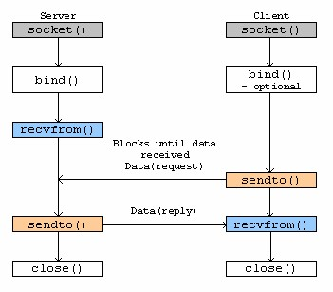
UDP Flow (connectionless)

Slide 10
Environment
Install Linux OS in a computer(VirtualBox or Vmware)
01
Using GCC for compiling
02
Using winsock for Windows Platform.
03

Slide 11
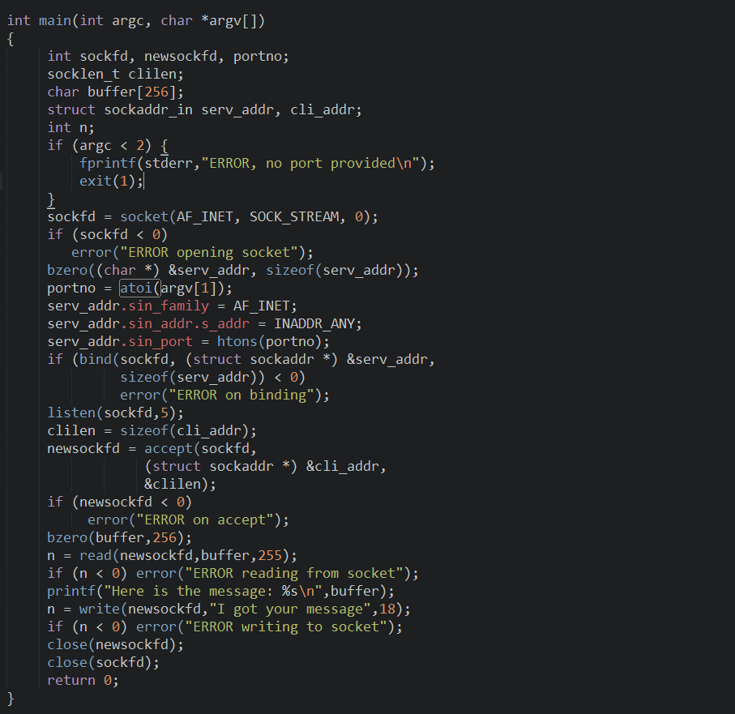
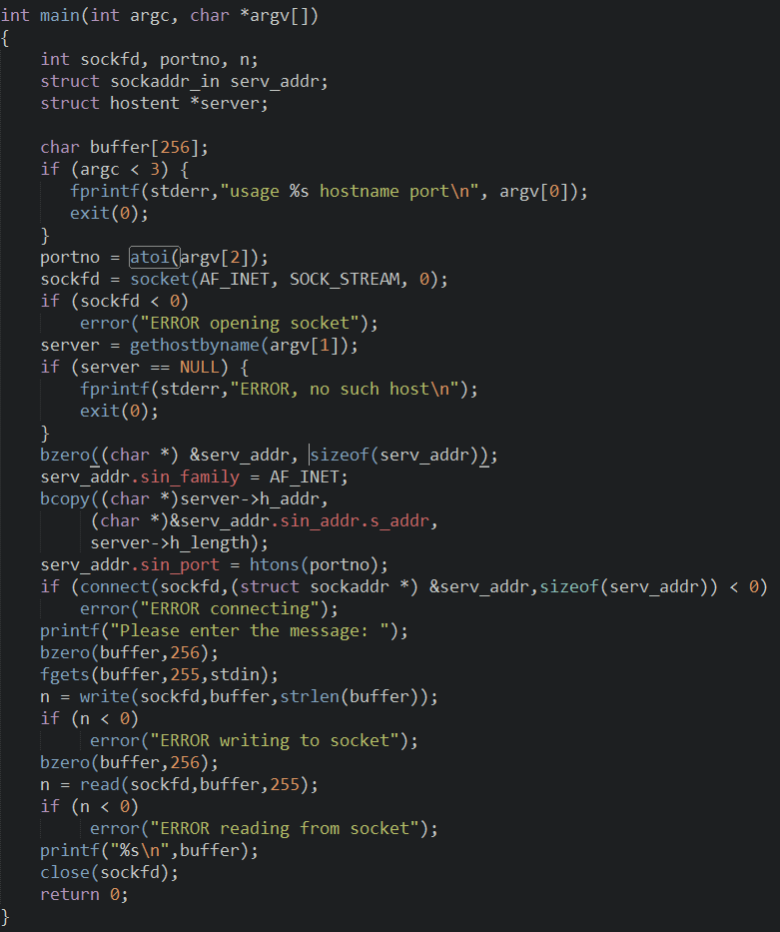
socket
socket
bind
connect
Listen & accept
write
read
read
write

Slide 12
TCP demo
np/tcp/echo_once/server.c
gcc –o server server.c
./server.c 5566
np/tcp/echo_once/client.c
gcc –o client client.c
./client.c localhost 5566

Slide 13
UDP demo
np/udp/echo/server.c
gcc –o server server.c
./server
np/udp/echo/client.c
gcc –o client client.c
./client

Slide 14
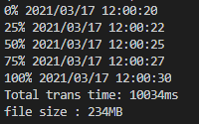
Lab 1 要求
分別使用 UDP 和 TCP 實現 File Transfer的功能
程式碼需附上詳細的註解
傳送之檔案，大小需大於200MB
報告須包含以下記錄 (範例如下)
每傳送25% 記錄一筆log
總傳輸時間(ms)
檔案大小
Tcp 和 udp 各執行過程

Slide 15
輸入為以下形式 (以 linux 為例)
執行檔需有5個參數
依序為tcp或udp, 傳送端或接收端, port, host, 傳送檔案路徑
$ ./lab1_file_transfer tcp send <ip> <port> test_input.txt
$./lab1_file_transfer tcp recv <ip> <port>
$./lab1_file_transfer udp send <ip> <port> test_input.txt
$./lab1_file_transfer udp recv <ip> <port>

Slide 16
Lab1作業繳交資訊
Moodle 上傳作業
報告請用ppt檔，code請用.c或.cpp檔，總共需要上傳兩個檔案(ppt + code)
將兩個檔案壓縮, 檔名用自己的學號加上編號命名
例如 P76031292_lab1.zip
DUE : 2021. 3. 30 .23:59
可參考網路上 socket 讀寫檔

